Slide 1

Project Title -
Nihal DR
INTERNSHIP_17546440516895be537820f

Slide 2

PROBLEM STATEMENT
Content Trends Analysis for Strategic Recommendations
Netflix faces competition from Amazon Prime, Disney+, and regional OTT providers. The aim is to analyze content distribution (Movies vs. TV Shows, genres, country contributions) to identify key trends and strategic insights.

Slide 3
Project Description
Dataset: 7,789 records, 11 columns (including title, director, cast, country, release date, rating, duration, genres)
Years covered: 2008-2021
Objectives: Analyze Movies vs. TV Shows distribution, identify popular genres, compare country contributions

Slide 4

WHO ARE THE END USERS?
Netflix content strategists
Data analysts
Business managers

Slide 5

Technology Used
Python – Core programming language
Pandas & NumPy – Data cleaning and preprocessing
Scikit-learn – Machine learning (model training, regression, evaluation)
Matplotlib/Seaborn – Data visualization and feature importance
Google Colab – Cloud-based environment for running the project
File handling libraries – openpyxl (for Excel) and built-in CSV handling

Slide 6
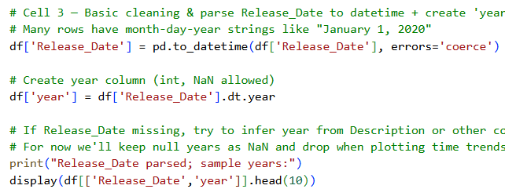
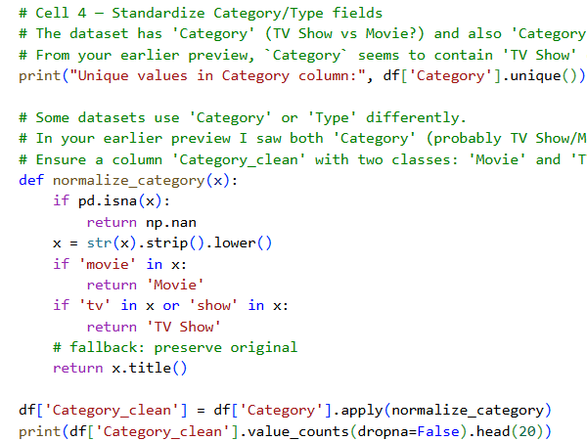
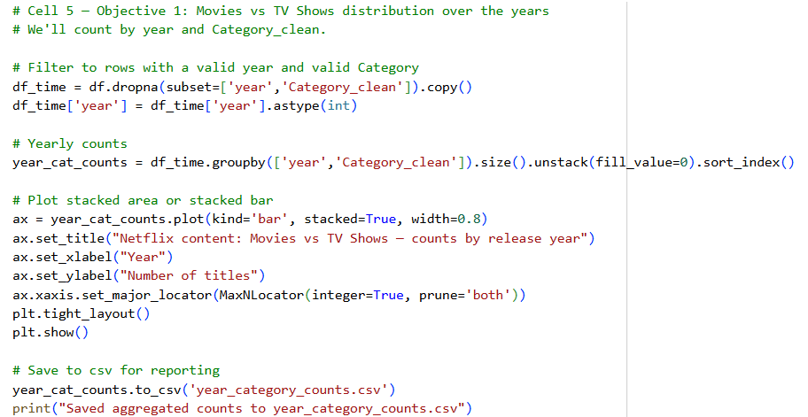
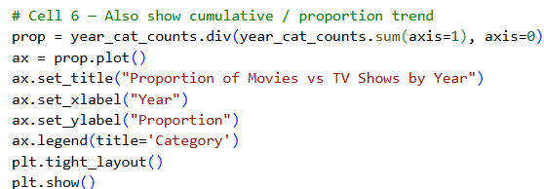
PYTHON CODE

Slide 7
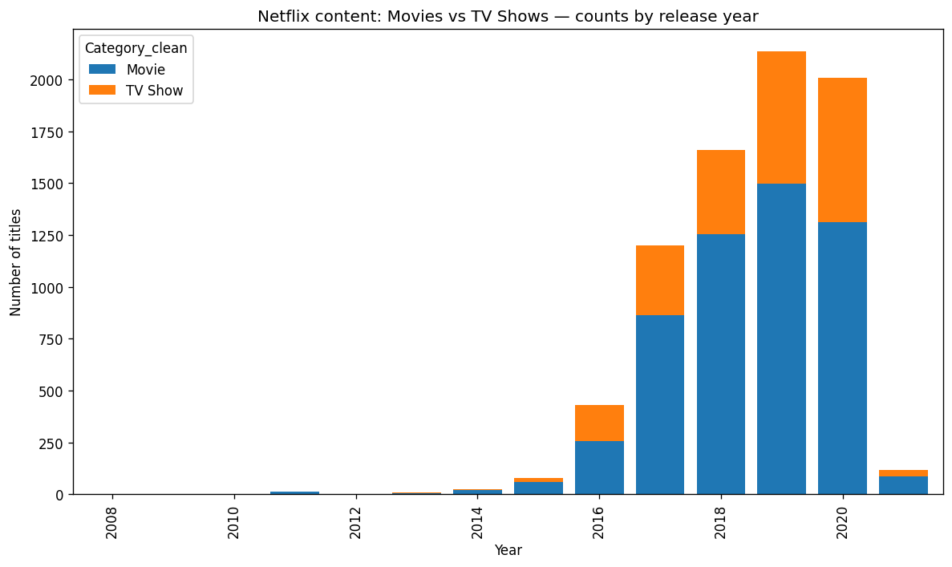
RESULTS1

Slide 8
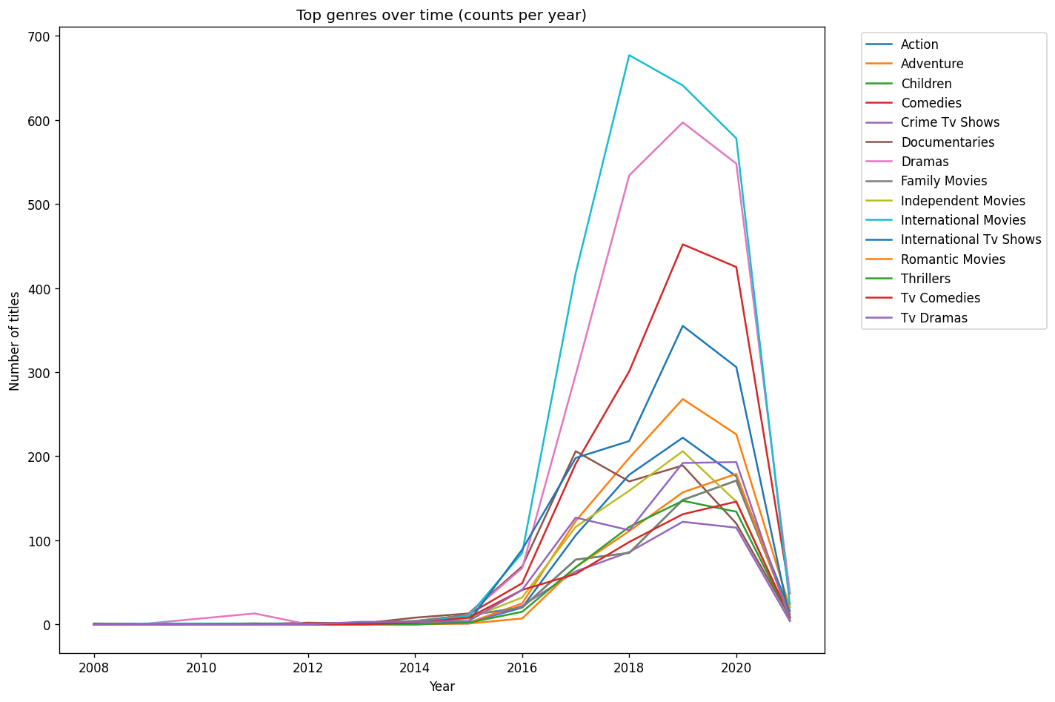
RESULTS2

Slide 9
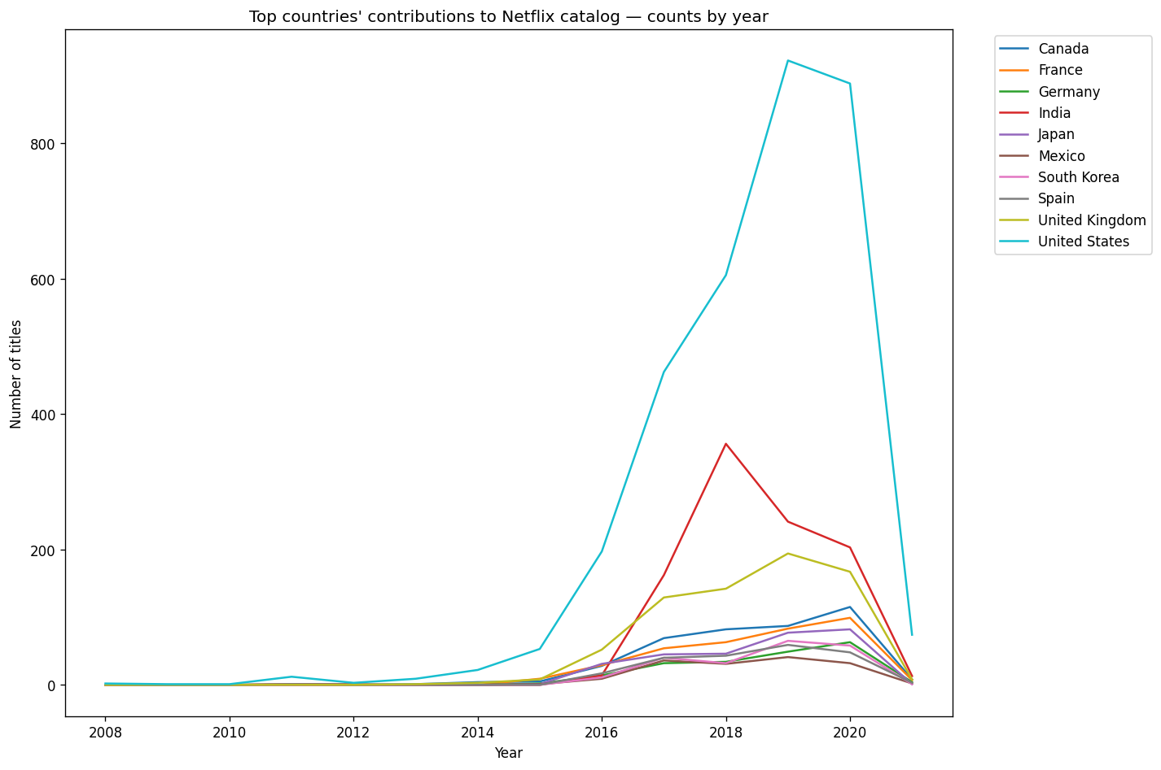

RESULTS3

Slide 10
GitHub repository
https://github.com/NihalDR/VOIS_AICTE_Oct2025_MajorProject_Nihal_DR.git

Slide 11

Getting started with Basics of Python Certificate

Slide 12

Data Visualization Certificate

Slide 13
Thank you
.
.

